Slide 1
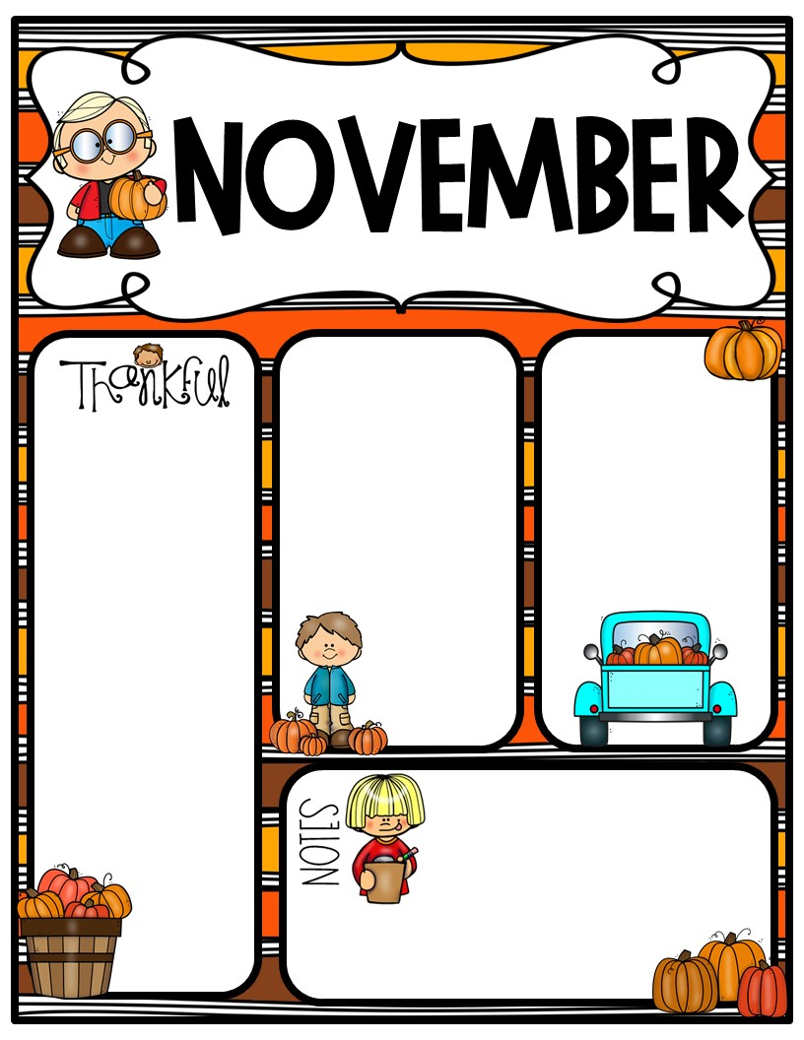
Week of Nov. 27-Dec. 1, 2023
Homework –
Math packet due Friday, Dec. 1st
Science homework due Friday, Dec. 1st
Parents,
Please check your email for an important message from me.
Math: Topic 7 – Data and Graphing
Monday – Area review
Tuesday –Test on Area
Wednesday – Topic 7 Lesson 1
Thursday – Topic 7 Lesson 2
Friday Topic 7 Lesson 3
Important Dates:
Nov. 27 – End of Spirit wear FLASH sale – check out the Richland PTO website.
Dec. 5 – Chick-fil-A Spirit Night
Dec. 15 – Year Book Cover Contest. Artwork should reflect the “Richland Vibes” theme
Dec. 15 – 1st Grade Holiday Program
Dec. 20 – Class Parties. Last
day before Winter
Break
UNIFORM REMINDER: Tops & Dresses: Red, White and Grey
Bottoms & Jumpers: Khaki, Navy,
or Black
Jackets/sweaters to wear indoors must be a
SOLID uniform color.

Slide 2
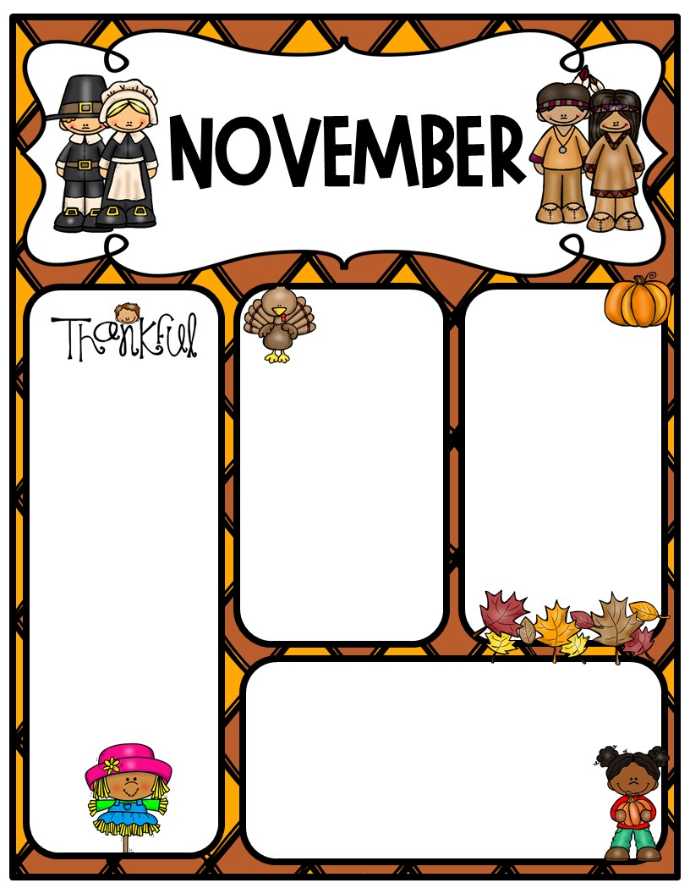
Week of Nov. 13-17, 2023
Newsletter
Homework –
Math packet due Friday, Nov. 17th
Thanksgiving break is next week, Nov. 20-24th. Enjoy!!
Important Dates:
Data Night – Thursday., 11/16 @ 5:30 pm
Field Trip to Botanic Garden Friday, Nov. 17th. Deadline to pay has been extended to Today, Nov. 13th
(Scroll down below for more info)
11/17 – Readathon Ends
Math: Topic 6 - Finding Area
Monday – Lesson 3
Tuesday –Lesson 4
Wednesday – Lesson 5
Thursday – Lesson 6
Friday Lesson 7
Reteach and Test on Module 6 the week after Thanksgiving Break.
UNIFORM REMINDER: Tops & Dresses: Red, White and Grey
Bottoms & Jumpers: Khaki, Navy,
or Black
Jackets/sweaters to wear indoors must be a
SOLID uniform color.

Slide 4
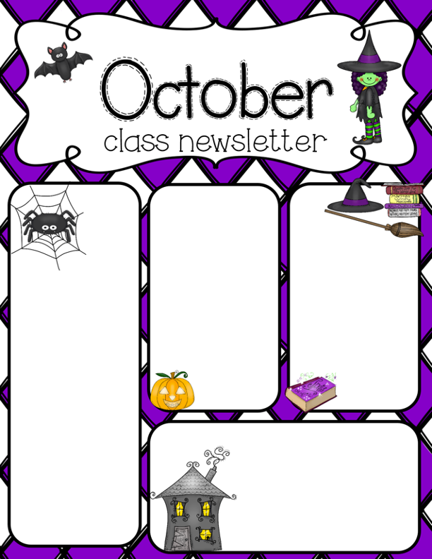
Week of Oct. 30-Nov. 3, 2023
Math: Topic 5
Properties of Multiplication and Division and Solving Problems
Monday – Lessons 5-3: Use strategies to multiply
Tuesday - Lessons 5-4: Solve Word Problems mult/div facts
Wednesday – Lessons 5-5Write Multiplication and Division Stories
Thursday – Topic 5 Test
Friday – Topic 6-1: Area with unit squares
Homework - Math packet due Friday
Science Energy – no homework
Open Book/Notes Quiz on energy this Wednesday (tentative)
Important Dates:
Mon., Oct. 30 – Pink Out! Day (wear uniform bottoms)
Tues. Oct. 31 – Halloween
Fri., Nov. 3 – Skate Night
Thur., Nov. 9 – Veteran’s Day Program @1:45 pm
Fri., Nov. 10 – No School (Veteran’s Day Observation)
Families,
If you have anyone in your family who has served our country in one of the Armed Forces, please send me their name and branch of service. We will honor them by adding their name on a star and displaying it for the program. You can send this information through Remind or email (darnellrr@scsk12.org)
Scroll Down for larger pic

Slide 5
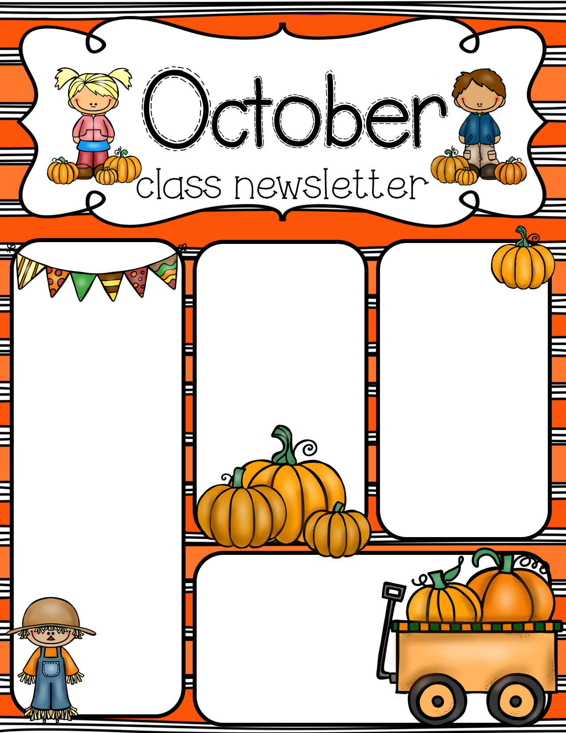
Week of Oct. 2-6, 2023
Science
Unit 1 Lesson 2 cont. –
Lesson 3:
Chemical and
Physical Changes
Quiz on Friday
Homework:
Math: Homework packet due Friday. This is a study guide for our upcoming Topic 4 test this Thursday. Questions will look exactly like the ones in the homework.
Math:
Topic 4 – Multiplication and Division Facts
Monday – 4-2 Using multiplication to
Tuesday –
Wednesday – Review
Thursday – Topic 4 Part 1 Test
Friday – Place Value Review/ Math Mystery
Click here for Mrs. Dollar’s Class Website
WATER BOTTLES: Please bring a refillable water bottle each day.
Important Dates:
10/02-10/06 - Book Fair
10/05 – Family Reading Night
10/09-10/13 Fall Break
10/21 – Trunk or Treat 3:00 pm

Slide 6
Week of Sept. 25-29, 2023
Science
Magnets and Electromagnets
Open Notes Quiz on Wednesday.
Homework:
Math:
No homework
was given out Monday. Our Encore class was cancelled, so I did not have a chance to copy homework. Students will receive it Tuesday, and it is still due on Friday, Sept. 29th
Science:
Science homework is one page, front and back. It is also due on Friday, Sept. 29th
Math: Topic 4 – Using Multiplication to Divide
Monday – Topic 3 Skills Review
Tuesday – Math Mastery Connect (district wide common assessment)
Wednesday –
Topic 4 Lesson 1 Relate Multiplication and Division
Thursday – Topic 4 Lesson 2 Use multiplication to divide with 2, 3, & 5
Friday – Topic 4 Lesson 3 Use multiplication to divide with 8 & 9
Click here for Mrs. Dollar’s Class Website
WATER BOTTLES: Please bring a refillable water bottle each day.
Important Dates:
9/26. Math Mastery Connect
9/27 School Picture Day
9/29 AGC Party
10/02-10/06 - Book Fair
10/05 – Family Reading Night
10/21 – Trunk or Treat 3:00 pm
Click HERE for Ms. Darnell’s Amazon Wish List!

Slide 7
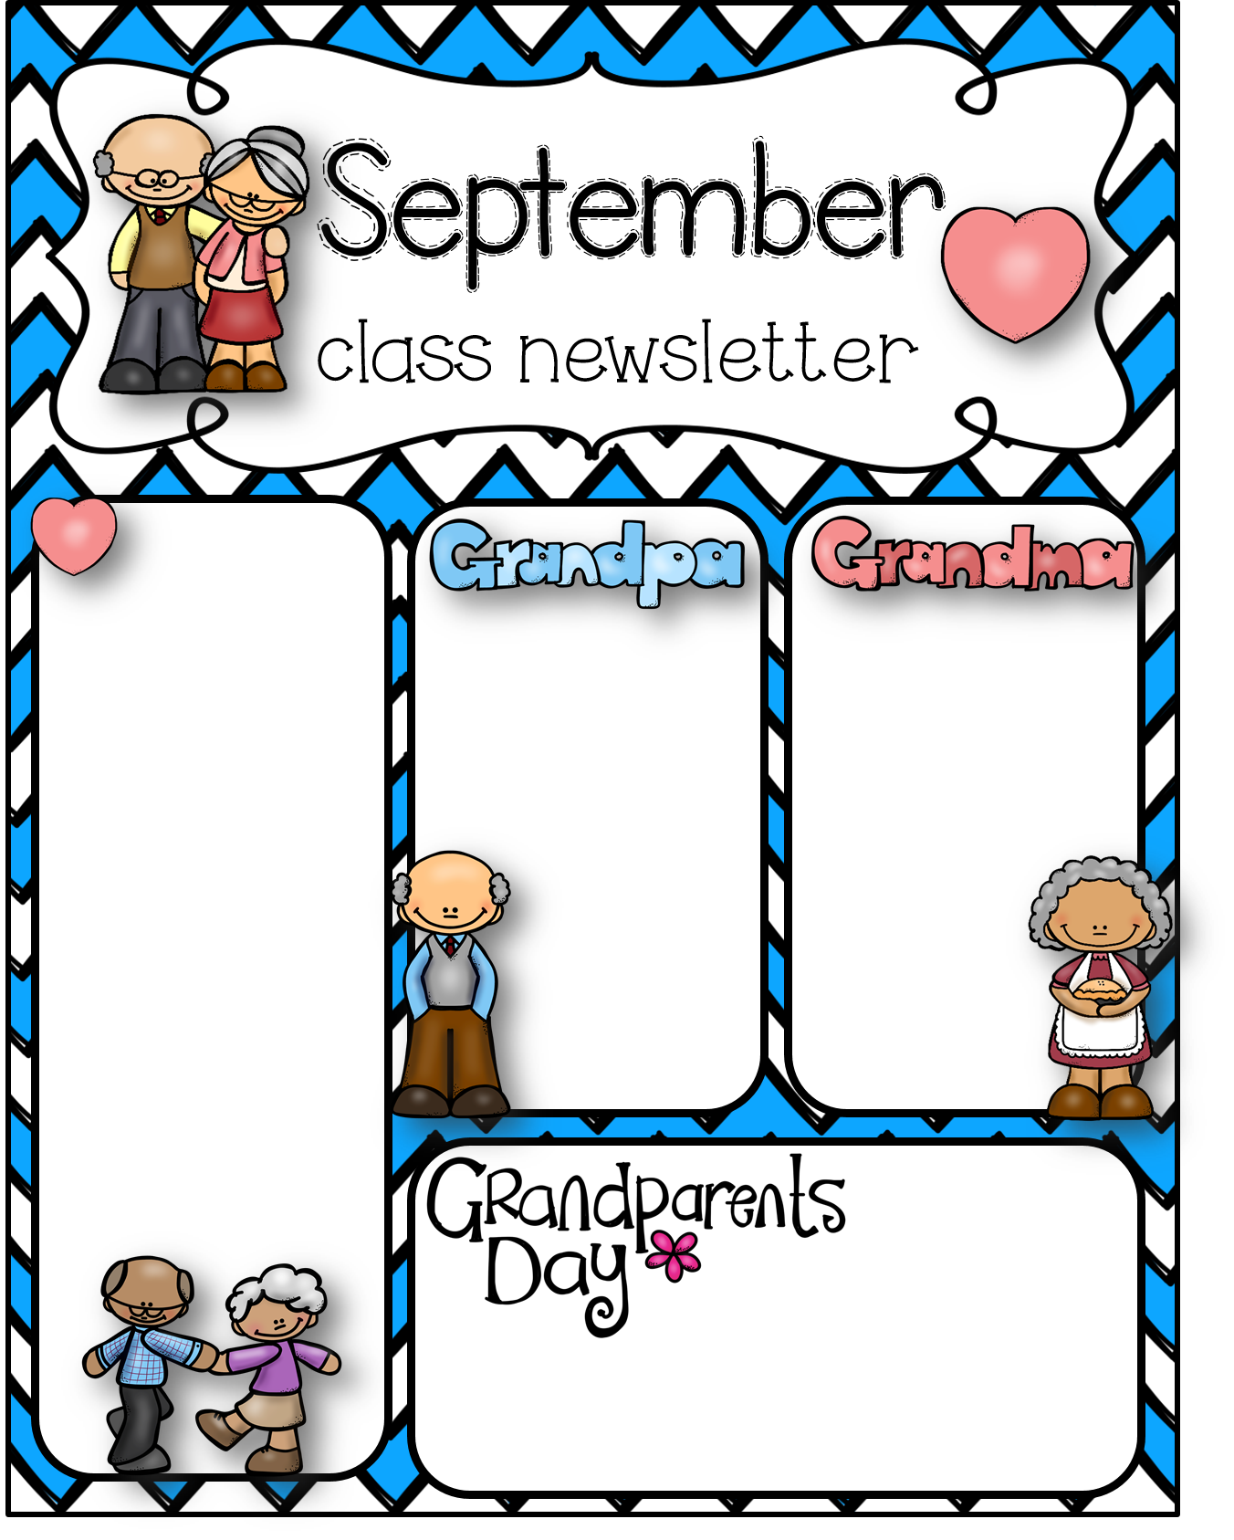
Week of Sept. 18-22, 2023
Math: Topic 3 - Multiplication
Monday – Topic 3 Lesson 4 factors of 8
Tuesday – Topic 3 Lesson 5 Practice Multiplication Facts
Wednesday –Topic 3 Lesson6 Multiplying with 3 factors
Thursday –Topic 3 Lesson 7 Problem Solving; Repeated Reasoning/Review
Friday – Topic 3 Lesson Test
Students need to be able to label arrays and break them apart using distributive property. Arrays are represented by
rows x columns.
It is extremely important to write the multiplication in this order.
Check out below (scroll down) for extra practice on arrays and Distributive Property!
Homework:
Math: packets are due on Friday. Students may turn them in early throughout the week.
Science homework is also due Friday.
Science : Magnets
North Pole
South Pole
Like poles Repel
Opposite poles Attract
Force
Metals attracted byu magnets
Quiz next Monday
Wednesday, Sept. 20, 2023
Lunch with your Grandparents!
Lunch for 3rd Grade is 10:30 am on Wednesday. This is the day scheduled for grandparents to come eat with your 3rd grader! Siblings from other grades may come and eat with them at this time, or your 3rd grader may be called if they come for another child’s time. Please refer to the flyer for other grades’ times.

Slide 8
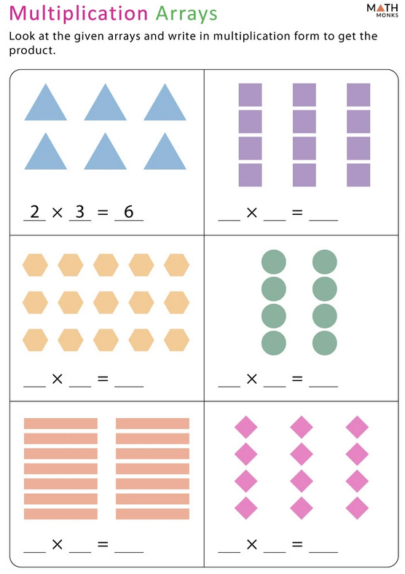
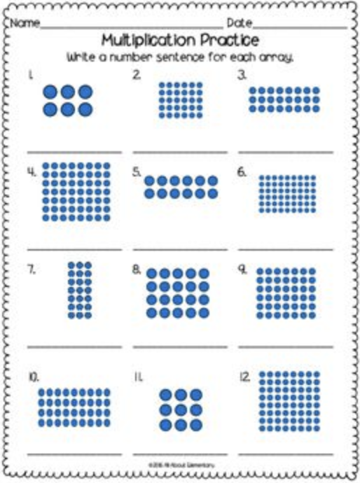
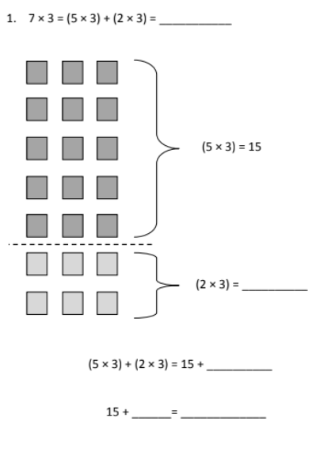
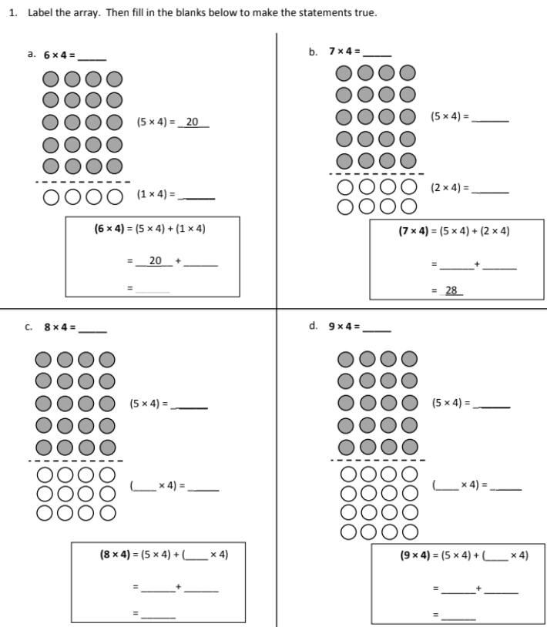
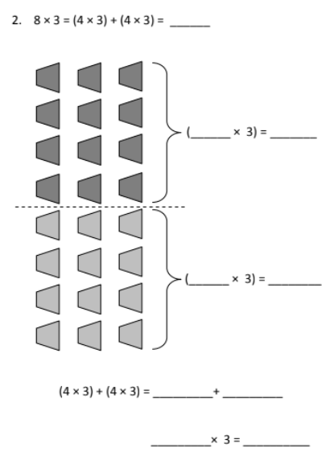

Slide 9
Week of Sept. 11-15, 2023
Science
Science Tools test Monday – open book
Matter test – open book
Unit 1
Lesson 3:
Chemical and
Physical Changes
Math: Topics 2 & 3 –
Monday – Lessons 2-5 & Review
Tuesday – Math Topic 2 Test
Wednesday - Topic 3 Lesson 1
Thursday – Topic 3 Lesson 2
Friday – Topic 3 Lesson 3
Homework:
Math: packets are due on Friday. Students may turn them in early throughout the week.
Click here for Mrs. Dollar’s Class Website
Important Dates:
9/15 Skate Night @ 5:15 pm
9/20 Grandparents Day Lunch for 3rd
9/27 School Picture Day
WATER BOTTLES: Please bring a refillable water bottle each day.

Slide 10
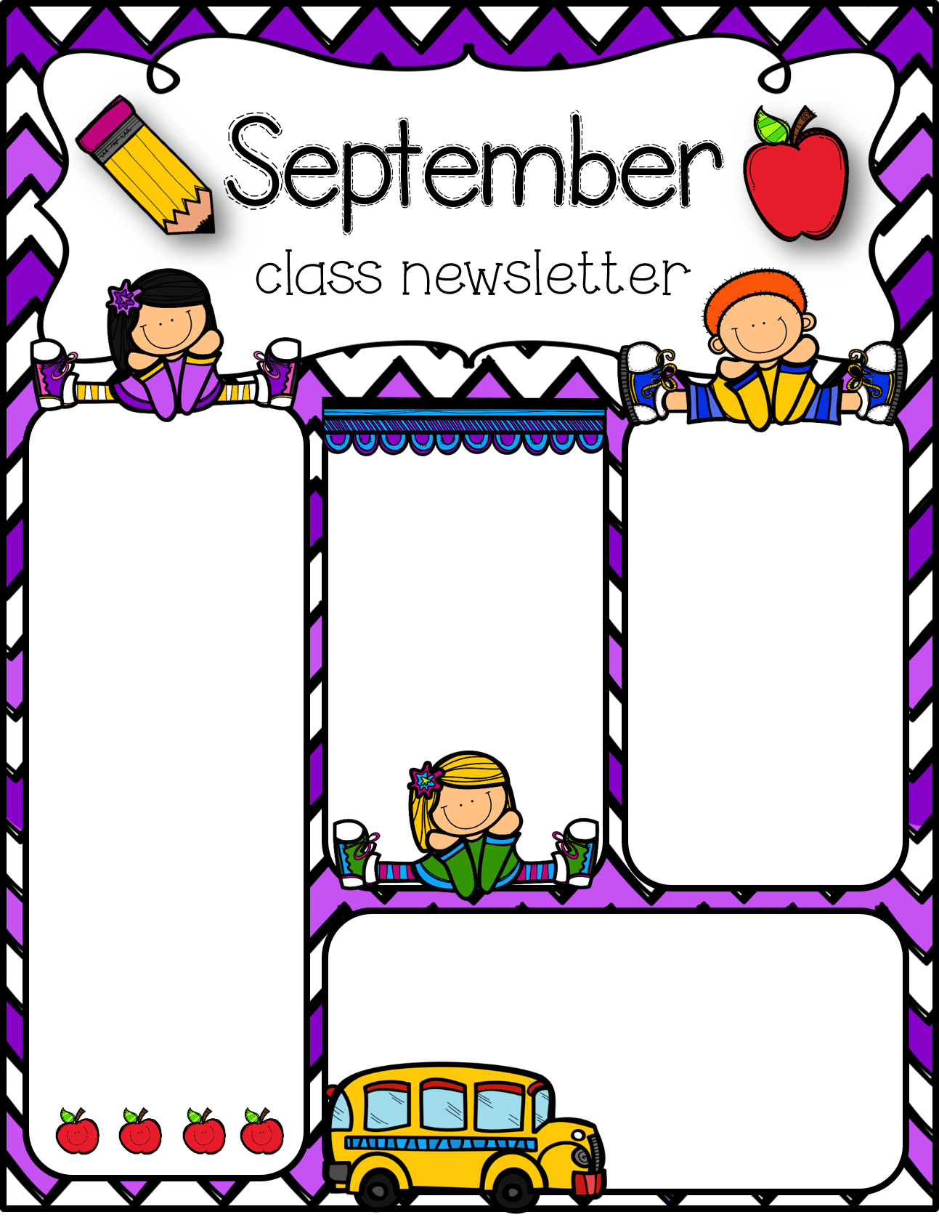
Week of Sept. 5-8, 2023
Math:
Monday – No School
Tuesday – Reteach Topic 1 Lessons 4 & 5 on dividing into equal groups
Wednesday –Review for Topic 1 Test
Thursday – Topic 1 Test and Addition Facts Fluency Test +0, +1, & +2
Friday – Begin Topic 2
Lesson 1 – Multiplying Facts using Patterns. X2, x5
Science
Matter: Continue/Review States of Matter and begin Changes in States of Matter
Quiz Friday, Sept. 8th – open notes (can use science journals we create in class)
Homework:
Math: packets are due on Friday. Students may turn them in early throughout the week.
Parent/Teacher Conferences
We will send out a link through Sign-up Genius for Parent Teacher Conferences. We will first send the link to parents with whom we would like to meet, then if spots are still available, we will send it to all parents.
Uniform Reminders:
Shirts – red, white, or grey
Bottoms – navy, black, or khaki
Inside Jackets or sweaters – any SOLID uniform color (no large logos)
WATER BOTTLES: Please bring a refillable water bottle each day.
Click HERE to go to Mrs. Dollar’s page!
Important Dates:
9/07 – Parent/Teacher Conferences 4-7pm
9/15 Skate Night @ 5:15 pm
9/20 Grandparents Day Lunch for 3rd
9/27 School Picture Day

Slide 11
August
Week of Aug. 28-Sept. 1, 2023
Math: Topic 1 – Understand Multiplication and Division of Whole Numbers
Monday – Topic 1 Lessons 4 & 5 Division: How many in each group; How many equal groups
Tuesday – Topic 1 Review
Wednesday –Topic 1 Test
Thursday – Begin Topic 2: Multiplication Facts; Use Patterns
Lesson 1: 2 and 5 as Factors
Friday – Topic 2 Lesson 2 – 9 as a Factor
Click HERE to go to Mrs. Dollar’s page!
Science Unit 1 Lesson 1 Properties of Matter
Quiz next Friday, Sept. 1st on Science Tools (open notes)
Homework:
Math: packets are due on Friday. Students may turn them in early throughout the week.
Important Dates:
9/04: Labor Day – No School
9/07 – Parent/Teacher Conferences 4-7pm
WATER BOTTLES: Please bring a refillable water bottle each day.
Uniform Reminders:
Shirts – red, white, or grey
Bottoms – navy, black, or khaki
Inside Jackets or sweaters – any SOLID uniform color (no large logos)

